Slide 2
Unit 5: Security in Cloud Computing (5hrs)
Cloud Security
  1.1 Cloud Security Threats
Security as a Service
Dimension of Cloud Security
Cloud Security Mechanism
  4.1 SSO, IAM, Hashing, and Digital Signatures
Disaster Management in Cloud Computing
Challenges of Cloud Security

Slide 3
Cloud Security
Cloud Security refers to the set of policies, technologies, controls, and services used to protect cloud-based systems, data, and infrastructure from unauthorized access, attacks, and data loss.
Cloud security is a shared responsibility between:
  Cloud Service Provider (CSP) – Physical data centers, infrastructure
  Cloud Customer – Data, applications, access management

Slide 4
Shared Responsibility Model
Layer | Responsibility
Physical Security | CSP
Network Infrastructure | CSP
Hypervisor | CSP
OS, Applications | Customer
Data & Access Control | Customer

Slide 5
Benefits of Cloud Security
1. Cost Efficiency
No need to purchase expensive security hardware
Pay-as-you-use security services
Using AWS Shield instead of on-premise DDoS appliances

Slide 6
Benefits of Cloud Security
2. Scalability and Flexibility
Security scales automatically with workload
Suitable for fluctuating traffic
Auto-scaling firewall rules during high traffic events

Slide 7
Benefits of Cloud Security
3. Advanced Security Infrastructure
Cloud providers invest heavily in security
Use AI/ML for threat detection
Google Cloud’s AI-based anomaly detection

Slide 8
Benefits of Cloud Security
4. Automatic Updates and Patching
Providers handle security updates
Reduces vulnerability exposure
Automatic OS patching in managed services

Slide 9
Benefits of Cloud Security
5. Data Encryption and Compliance
Encryption at rest and in transit
Supports global compliance standards
HIPAA-compliant healthcare cloud storage

Slide 10
Benefits of Cloud Security
7. Identity and Access Control
Fine-grained access control
Role-based access management
IAM policies restricting admin privileges

Slide 11
Challenges of Cloud Security
1. Data Privacy and Confidentiality
Data stored in third-party data centers
Risk: Regulatory and legal issues
2. Shared Responsibility Complexity
Users misunderstand their responsibilities
Risk: Misconfiguration leading to breaches

Slide 12
Challenges of Cloud Security
3. Vendor Lock-In
Security tools are provider-specific
Risk: Difficult migration between clouds
4. Misconfiguration and Human Error
Incorrect security settings
Example: Publicly exposed storage buckets

Slide 13
Challenges of Cloud Security
5. Insider Threats
Malicious or careless employees
Example: Admin misuse of privileges
6. Internet Dependency
Cloud security depends on internet connectivity
Risk: Service unavailability during outages

Slide 14
Challenges of Cloud Security
7. Limited Visibility and Control
No access to physical infrastructure
Risk: Difficulty in forensic investigations

Slide 15
Cloud Security Threats
Cloud security threats are risks that compromise confidentiality, integrity, and availability (CIA Triad).

Slide 16
Cloud Security Threats
1. Data Breach
Unauthorized access to sensitive data.
Example:
Exposed S3 bucket containing customer records
Impact:
Financial loss
Legal penalties
Reputation damage

Slide 17
Cloud Security Threats
2. Data Loss
Accidental deletion, ransomware, or hardware failure.
Example:
Deleting a production database without backup
Prevention:
Backup & versioning
Replication

Slide 18
Cloud Security Threats
3. Insecure APIs
APIs expose cloud services to attackers.
Example:
Weak authentication on REST APIs
Mitigation:
API Gateway
OAuth, JWT tokens

Slide 19
Cloud Security Threats
4. Account Hijacking
Attackers gain control of cloud accounts.
Example:
Stolen IAM credentials used to launch crypto-mining VMs
Prevention:
Multi-Factor Authentication (MFA)
IAM policies

Slide 20
Cloud Security Threats
5. Insider Threat
Malicious or careless employees.
Example:
Admin accidentally exposing database publicly
Mitigation:
Least privilege principle
Activity logging

Slide 21
Cloud Security Threats
6. Denial of Service (DoS / DDoS)
Overloading cloud services.
Example:
Traffic flood taking down an e-commerce site
Protection:
Auto-scaling
DDoS protection services

Slide 22
Cloud Security Threats
7. Misconfiguration
Most common cloud threat.
Example:
Open security groups (0.0.0.0/0)
Mitigation:
Security audits
Automated policy checks

Slide 23
Cloud Security Threats
8. Malware Injection
Attacker injects malicious code.
Example:
Infected VM image used by users
Prevention:
Image scanning
Trusted repositories

Slide 24
Cloud Security Threats Mapping
Threat | Affects
Data Breach | Confidentiality
Data Loss | Integrity
DDoS | Availability
Insider Attack | All
API Attack | Confidentiality

Slide 25
Security as a Service (SECaaS)
Security as a Service is a cloud-based delivery model where security services are provided on demand by cloud providers instead of being implemented on-premises.
Security itself becomes a cloud service.

Slide 26
SECaaS
Traditional security systems:
  Require heavy investment
  Are difficult to scale
  Need constant updates and monitoring
Cloud environments demand:
  Elastic security
  Real-time threat detection
  Centralized management
SECaaS addresses these needs efficiently.

Slide 27
Why SECaaS?
Reduces security infrastructure cost
Automatic updates
Scalable and comprehensive protection
Centralized management

Slide 28
Cloud-Based E-Commerce Platform
IAM controls admin roles
TLS encryption for transactions
DDoS protection during sales
Monitoring logs for audit
Backup and disaster recovery

Slide 29
Challenges of SECaaS
Vendor dependency
Limited customization
Privacy concerns
Compliance complexity

Slide 30
Dimensions of Cloud Security
Cloud security is multi-dimensional, meaning it does not rely on a single mechanism.
Instead, it combines technical, organizational, legal, and operational dimensions to ensure protection of cloud resources.

Slide 31
Dimensions of Cloud Security
Data Security Dimension
  Protection of data stored, processed, and transmitted in the cloud.
    Data encryption (at rest & in transit)
    Backup and recovery
    Data integrity
    Data lifecycle management

Slide 32
Dimensions of Cloud Security
Identity and Access Management (IAM) Dimension
  Controls who can access cloud resources and what actions they can perform.
    User authentication
    Role-based access control (RBAC)
    Multi-Factor Authentication (MFA)
    Least privilege principle
  Example: Developer can read logs but cannot delete databases

Slide 33
Dimensions of Cloud Security
Application Security Dimension
  Ensures cloud applications are free from vulnerabilities.
    Secure coding
    Input validation
    API security
    Application firewall
  Example: Web Application Firewall (WAF) blocking SQL injection

Slide 34
Dimensions of Cloud Security
Network Security Dimension
  Protects cloud networking components and traffic.
    Firewalls
    Security Groups
    Network ACLs
    VPNs
  Example: Private subnets with no internet access, VPN connecting on-premise to cloud

Slide 35
Dimensions of Cloud Security
Infrastructure Security Dimension
  Protects the underlying cloud infrastructure including physical and virtual resources.
    Secure hypervisors
    Physical data center security
    Host OS protection
  Mostly handled by Cloud Service Provider

Slide 36
Dimensions of Cloud Security
Compliance and Legal Dimension
  Ensures cloud usage meets legal, regulatory, and industry standards.
  Commonly used Standards are:
    GDPR
    HIPAA
    ISO/IEC 27001
    PCI-DSS
  Example: Storing EU customer data only in EU regions

Slide 37
Dimensions of Cloud Security
Monitoring and Incident Response Dimension
  Continuous monitoring and quick response to security incidents.
    Log management
    Intrusion detection
    Alert systems
  Example: Detecting unusual login attempts

Slide 38
Dimensions of Cloud Security
Disaster Recovery and Business Continuity Dimension
  Ensures service availability during failures or disasters.
    Backup
    Replication
    Failover
    Multi-region deployment
  Example: Automatic failover to another region

Slide 39
Dimensions of Cloud Security
Governance and Policy Dimension
  Defines rules, policies, and procedures for cloud usage.
    Security policies
    Risk management
    Auditing
  Example: Policy requiring MFA for all admin users

Slide 40
Dimensions of Cloud Security
Dimension | Confidentiality | Integrity | Availability
Data Security | ✔ | ✔
IAM | ✔ | ✔
Network Security | ✔ |  | ✔
Monitoring |  | ✔ | ✔
Disaster Recovery |  |  | ✔

Slide 41
Cloud Security Mechanism
Cloud Security Mechanisms are technical controls used to protect cloud systems, data, and users by ensuring:
  Authentication (Who are you?)
  Authorization (What can you do?)
  Integrity (Has data been altered?)
  Non-repudiation (You cannot deny your action)

Slide 42
Single Sign-On (SSO)
Single Sign-On (SSO) allows a user to log in once and access multiple cloud services without re-entering credentials.
SSO has single authentication server, managing multiple accesses to other systems.

Slide 43
SSO Working Mechanism
Step 1: User Requests Access
  The user tries to access a cloud application (Service Provider).
Step 2: Redirect to Identity Provider
  The application redirects the user to a trusted Identity Provider (IdP).
Step 3: User Authentication
  The user enters credentials (username/password, MFA, biometrics).
Step 4: Token Generation
  If authentication is successful, the IdP generates a security token.
Step 5: Token Exchange
  The token is sent back to the cloud application.
Step 6: Access Granted
  The application validates the token and grants access.
Step 7: Access to Multiple Services
  The same token is reused to access other cloud services without re-authentication

Slide 44
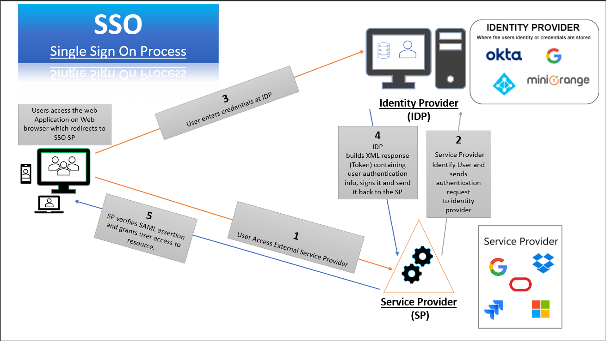
SSO Working Mechanism

Slide 45
OpenID
OpenID is an authentication protocol that allows users to log in to multiple applications using a single digital identity.
Modern cloud systems use OpenID Connect (OIDC), which is built on top of OAuth 2.0.
OpenID Connect provides secure user authentication using tokens.
Example: Students log in using Google ID in University Cloud Portal.

Slide 46
Advantages of SSO
Improved user experience
Reduced password fatigue
Centralized authentication
Better security control

Slide 47
Identity and Access Management (IAM)
IAM is a mechanism that controls access to cloud resources by defining:
  Who (user, role, service)
  What (permissions)
  Under which conditions
IAM ensures right user → right access → right resources → right time.
Authentication (Who are you?)
Authorization (What can you do?)
User lifecycle management
IAM Examples: AWS IAM, Azure AD, Okta

Slide 48
Identity and Access Management (IAM)
1. Identity
A digital representation of a user, system, or device.
  Username
  Email
  Employee ID
  Role

Slide 49
Identity and Access Management (IAM)
2. Authentication (Who are you?)
Verifies user identity.
Methods:
  Passwords
  OTP
  Biometrics
  Smart cards
  Multi-Factor Authentication (MFA)
Example: Login using password + OTP.

Slide 50
Identity and Access Management (IAM)
3. Authorization (What can you do?)
Determines access permissions.
Models:
  Role-Based Access Control (RBAC)
  Attribute-Based Access Control (ABAC)
  Policy-Based Access Control
Example: Admin can edit data; user can only view.

Slide 51
Identity and Access Management (IAM)
4. Accounting / Auditing
Tracks user actions for security and compliance.
Login logs
Activity logs
Access reviews

Slide 52
Identity and Access Management (IAM)
5. Access Control
Defines the rights and permissions that users and devices have to access systems, applications, and data.
  Principles:
    Least Privilege: Users should only have the minimum necessary permissions to perform their tasks.
    Separation of Duties: Certain tasks and responsibilities are divided among different individuals to prevent fraud or errors.
    Zero Trust Principle, Role-based access control (RBAC)

Slide 53
IAM Lifecycle (User Lifecycle Management)
1. Provisioning
  Creating user accounts and assigning roles.
2. Access Management
  Granting or modifying permissions.
3. De-provisioning
  Removing access when a user leaves.
Example: Employee leaves company → access revoked immediately.

Slide 54
Why IAM is Important
Prevents unauthorized access
Protects sensitive data
Reduces insider threats
Supports compliance
Enables secure remote access
Example: Only teachers can upload grades; students can only view them.

Slide 55
IAM Best Practices
Use Multi-Factor Authentication (MFA)
Implement the Principle of Least Privilege
Regular Access Reviews
Centralized Identity Management
Enforce Strong Password Policies
Automate Provisioning and De-Provisioning

Slide 56
Hashing
Hashing is a one-way cryptographic process that converts data into a fixed-length hash value.
Password protection
  Original Data → Hash Function → Hash Value
Common Hash Algorithms
  SHA-256
  SHA-512
  MD5 (not secure)

Slide 57
Hashing
Key Properties
  One-way function
  Same input → same hash
  Small change → big hash change
Usage
  Password storage
  Data integrity verification

Slide 58
Digital Signatures
A Digital Signature is a cryptographic mechanism that ensures:
  Authenticity
  Integrity
  Non-repudiation
Example
  Secure software updates
  Cloud API request signing
  Legal Document Verification

Slide 59
How Digital Signature Works
Message → Hash → Encrypt (Private Key) → Signature
Sender hashes the message
Hash encrypted using sender’s private key
Receiver decrypts using public key
Hash compared

Slide 60
Disaster Management in Cloud
Disaster Management in Cloud Computing refers to the planning, implementation, and execution of strategies that ensure business continuity and data protection when unexpected failures or disasters occur to ensure availability, reliability and rapid recovery of cloud services.
A disaster can cause:
  Data loss
  Service downtime
  Financial loss
  Reputation damage

Slide 61
Disaster Management in Cloud
1. Natural Disasters
Earthquake
Flood
Fire
2. Technical Failures
Hardware failure
Power outage
Network failure
3. Cyber Disasters
DDoS attacks
Ransomware
Data breaches
4. Human Errors
Accidental deletion
Misconfiguration

Slide 62
Disaster Recovery Strategies in Cloud
Backup and Restore: Regular backups stored in cloud storage
Pilot Light Strategy: Minimal core services always running
Warm Standby: Fully functional backup environment with reduced capacity
Hot Standby (Active-Active): Two fully active environments

Slide 63
Disaster Recovery Strategies in Cloud
Benefits of Cloud-Based Disaster Management
  Lower cost than on-premises
  Faster recovery
  Geographic redundancy
  Automated failover
Challenges of Disaster Management in Cloud
  Cost of multi-region setup
  Complexity in planning
  Compliance constraints
  Dependency on provider

Slide 64
CSA Model
A particular service model defines the boundary between the responsibilities of service provider and
consumer. Cloud Security Alliance (CSA) stack model defines the boundaries between each service model and
shows how different functional units relate to each other. The following diagram shows the CSA stack model:

Slide 65
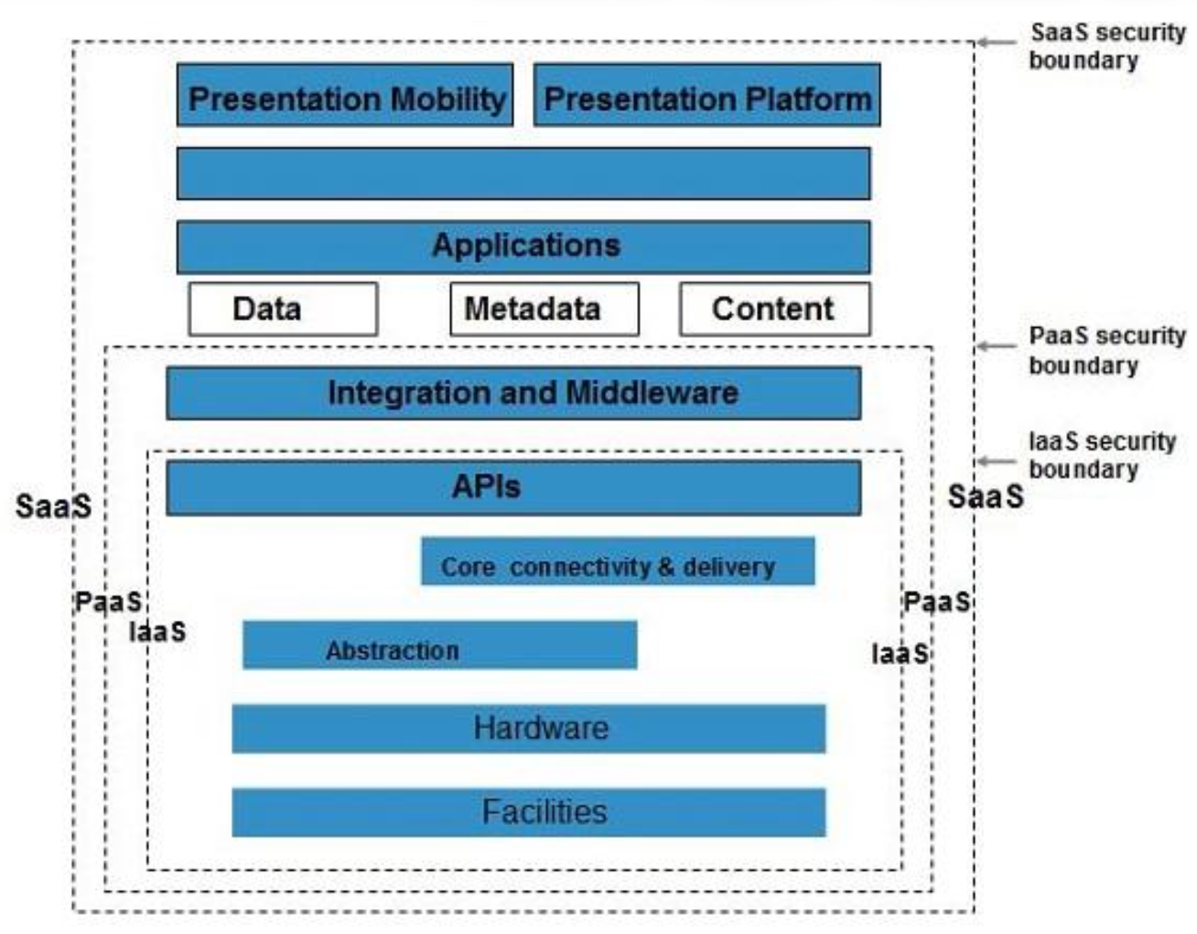
CSA Model

Slide 66
CSA Model
IaaS is the most basic cloud service model
PaaS and SaaS are higher-level services built on IaaS
Each higher model inherits capabilities and security risks of lower layers
IaaS has the least integrated functionality and security
SaaS has the most built-in functionality and security
CSA model defines the security boundary between provider and consumer
Below the boundary: security handled by cloud provider
Above the boundary: security managed by cloud consumer

Slide 67
End of
Unit 5

Slide 68
Discussion

